Slide 1

Creating Technical Presentations
Principles for Creating High-Quality Tech Presentations
SoftUni Team
Technical Trainers
Software University
http://softuni.bg

Slide 2
Table of Contents
Fundamentals of Technical Presentation
Objectives
Structure
Design Guidelines
Typical Mistakes
From Bad to Good Slides

Slide 3

Fundamentals
Objective, Structure, Design Guidelines

Slide 4
Objectives
Learn by examples
Less theory, more "live examples"
Avoid explanatory slides, show more code
Follow the "Learn by doing" principle
Slides as textbook:
For the students
For the trainer

Slide 5
Presentation Structure
Intro section
Cover slide + Table of Content + Sli.do
Content section
Section cover slide
Theory + examples
Practical problems
Conclusion
Summary + Question + Licenses + SoftUni Banners

Slide 6
Design Guidelines
Use English
Less text – use short bullets, not full sentences
Less theory
Explain the theory by code examples
Animate the displaying of the source code
Use images / diagrams for important concepts
Timing
Use short presentations – 20 – 40 slides
Theory + Examples + Practical problems + Break

Slide 7
Design Guidelines (2)
Slide titles
Use short slide titles
Capitalize Each Slide Title Word (except prepositions and conjunctions)
Fonts
Use the font sizes coming from the template
Use Calibri for the text on the slides
Use font Consolas + bold for the source code

Slide 8
Design Guidelines (3)
Colors
Use the colors coming from the template
Never use low contrast colors (e.g. red on black background)
Metadata
Fill the document properties: title, tags, categories, comments, subject, company, author

Slide 9

Typical Mistakes
How to Turn Bad Slides into Good

Slide 10
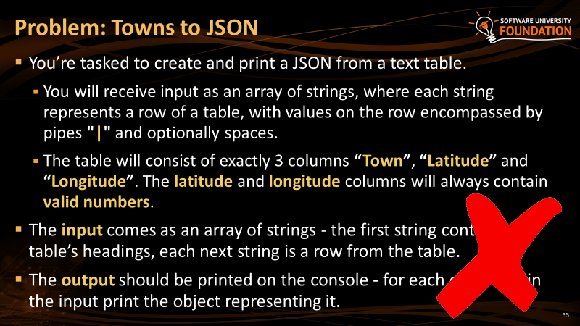
Too Much Text on the Slide
Don't use complete sentences, use short bullets
If the information is much, after sentences were made short, reduce it

Slide 11
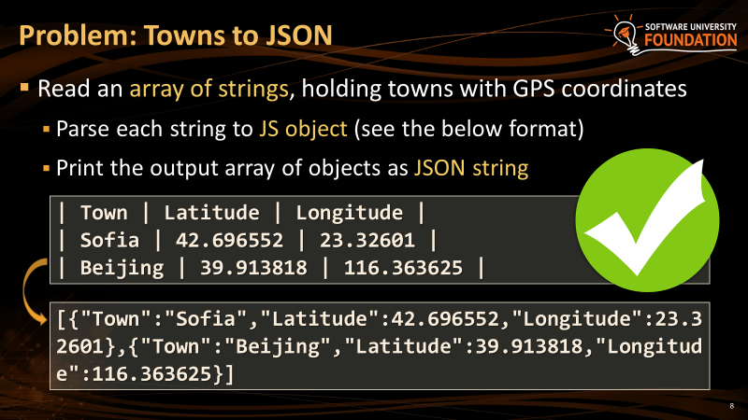
Too Much Text on the Slide - Fixed
Describe the problem very briefly
Give good examples to describe the problem better

Slide 12
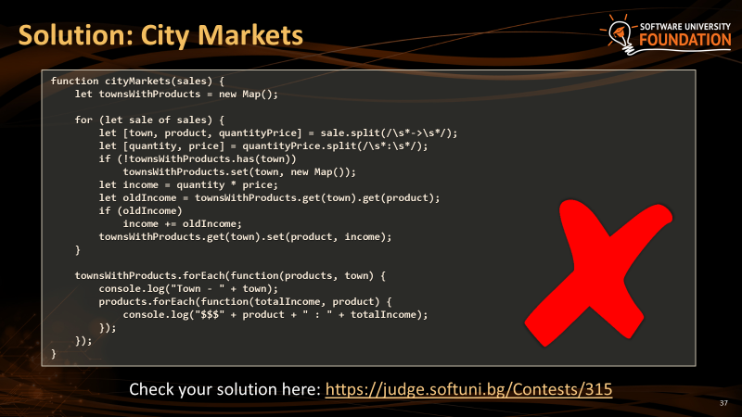
Too Much Code on the Slide
Don't use font size less than 24pt
Prefer font size 28pt or 30pt
The content should be readable from the last row

Slide 13
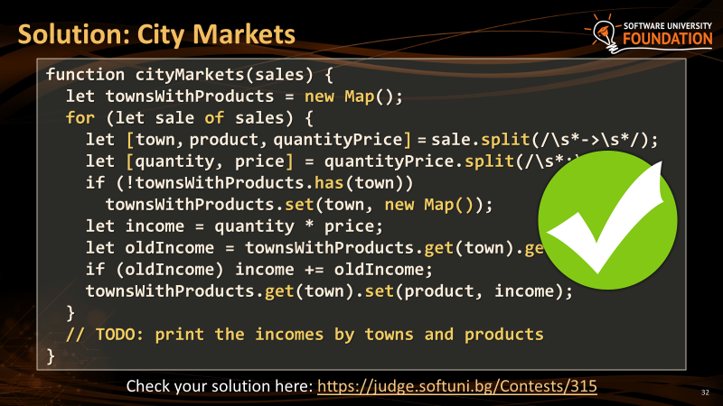
Too Much Code on the Slide - Fixed
Reduce the code by removing unimportant parts (insert TODOs)
Split the code into several slides

Slide 14
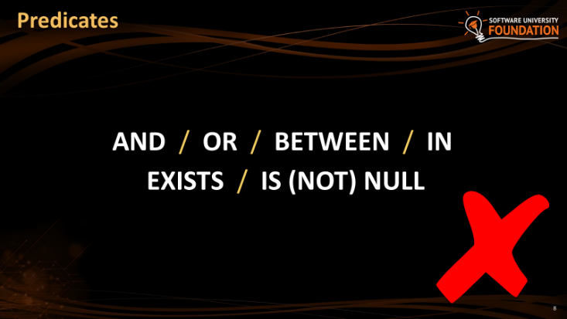
Missing Code Example
Technical slides should hold examples, not mentions
Give examples for these predicates

Slide 15
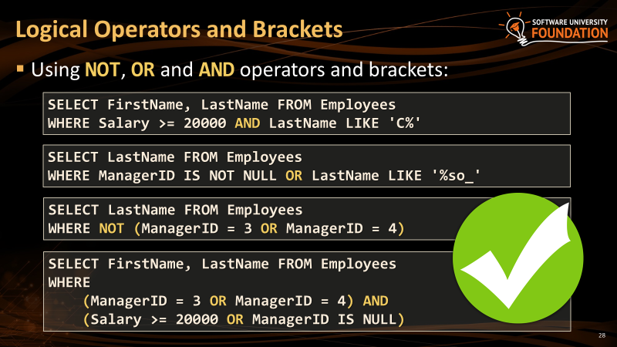
Missing Code Example - Fixed
Focus on code examples
People learn best with examples, followed by live coding
Follow the concept "learn by examples"

Slide 16
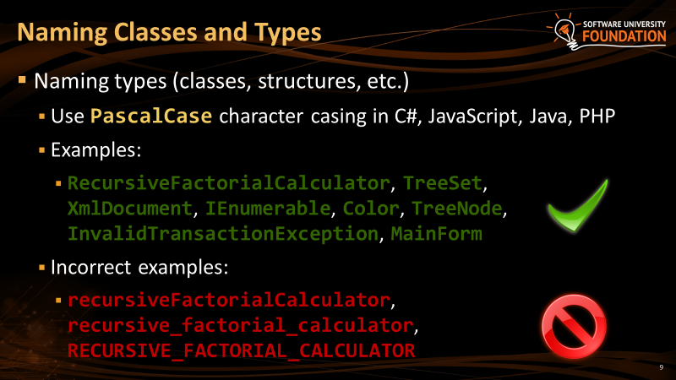
Inappropriate Colors
The colors on the slide are bad
Low contrast
Applicable for pictures too
Keep in mind the multimedia projector

Slide 17
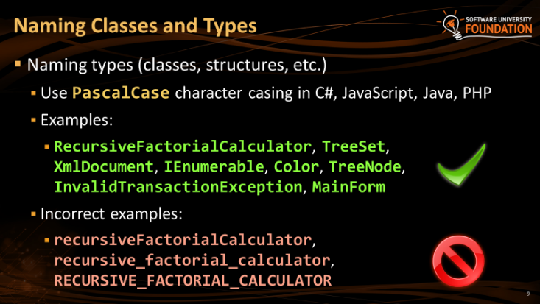
Inappropriate Colors - Fixed
Improve colors with higher contrast
Use the colors from the template

Slide 18
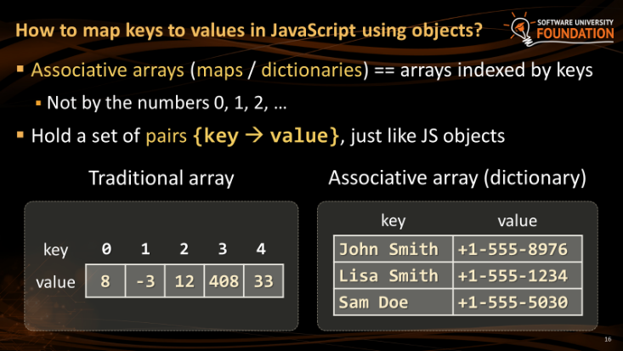
Bad Slide Titles
Slide title is too long
Title casing is incorrect → should be "Capital Case"

Slide 19
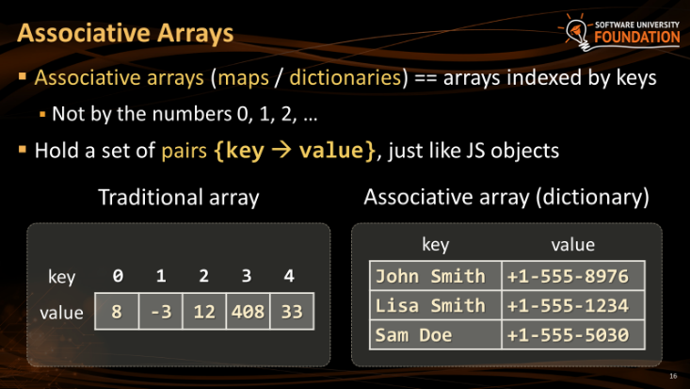
Bad Slide Titles - Fixed
Explains the slide in short
It is in "Capital Case"
Each word starts with a capital letter except (a, the, and, or, not)

Slide 20
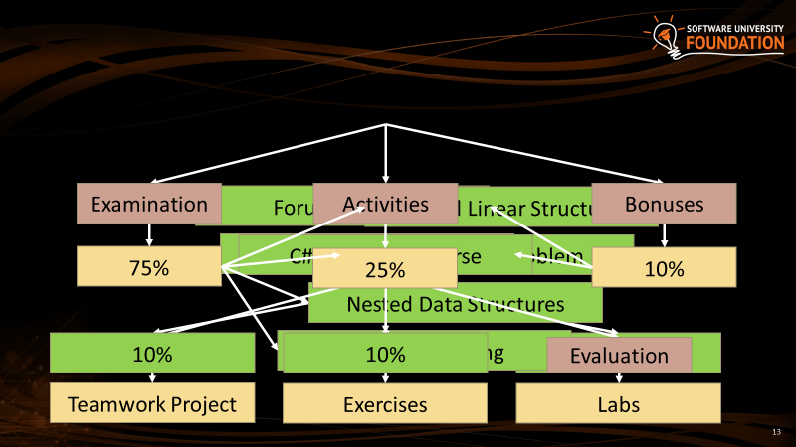
Overlapping Content
Cannot be read without playing the animations
The slides cannot be used as textbook / reference / guide

Slide 21
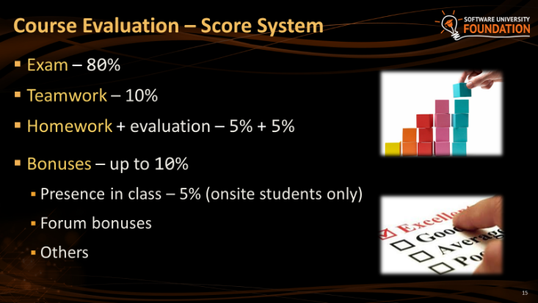
Overlapping Content - Fixed
No overlapping content
The slide is readable
Animations still can be used to show the evaluation components one by one

Slide 22
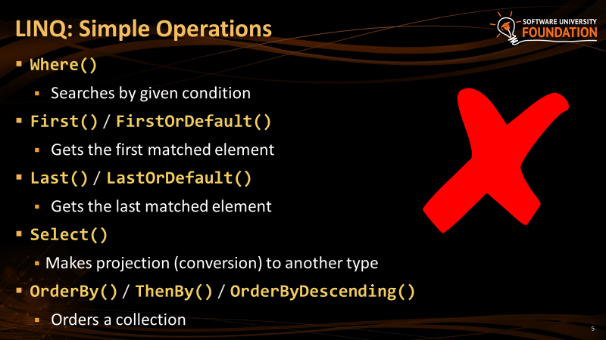
Explaining Methods and Parameters
The content is too much
Split it into two slides
Examples are missing
Slides like this are really boring

Slide 23
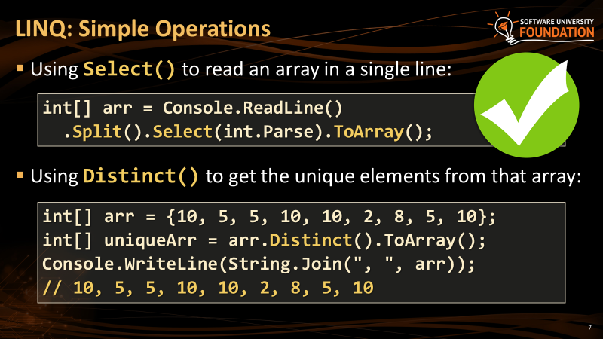
Explaining Methods and Parameters - Fixed
Slides have less content and bigger fonts
The code examples are improved
The output improves the understandability

Slide 24
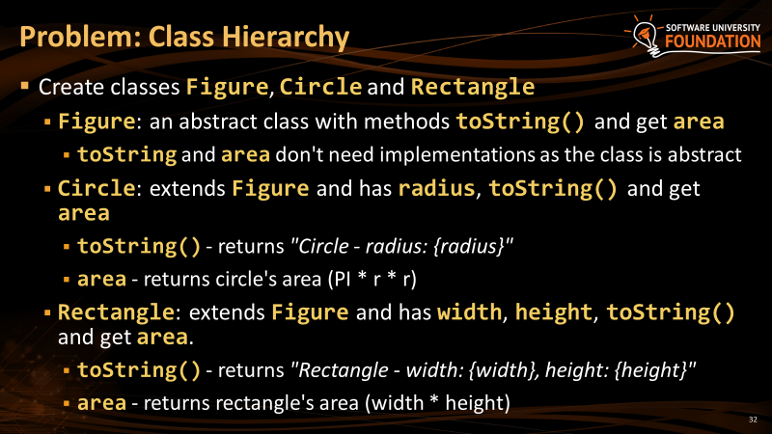
Over-Descriptive Slide
Slides are not books, mention the important information only
The explanations are over-descriptive
Avoid full sentences, just keywords / phrases

Slide 25
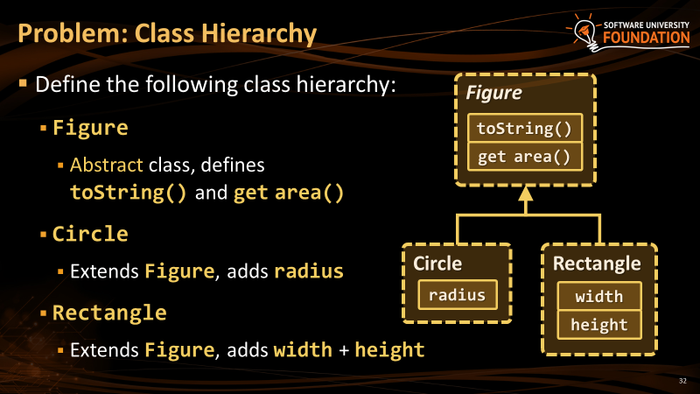
Over-Descriptive Slide - Fixed
Add pictures for better visualization and less text
The same class hierarchy is visualized, not described with text
The text is significantly reduced

Slide 26

Summary
…
…
…
Objectives, structure and design guidelines of a technical presentation
Differences between good and bad slides
Refactoring bad slides to good

Slide 27
https://softuni.bg/opencourses/train-the-trainers

Slide 28

License
This course (slides, examples, demos, videos, homework, etc.) is licensed under the "Creative Commons Attribution-NonCommercial-ShareAlike 4.0 International" license

